Slide 1

Spring Configuration with Java Code

Slide 2
Java Configuration
•
Instead of configuring Spring container using XML
•
Configure the Spring container with Java code
No XML!
www.luv2code.com

Slide 3
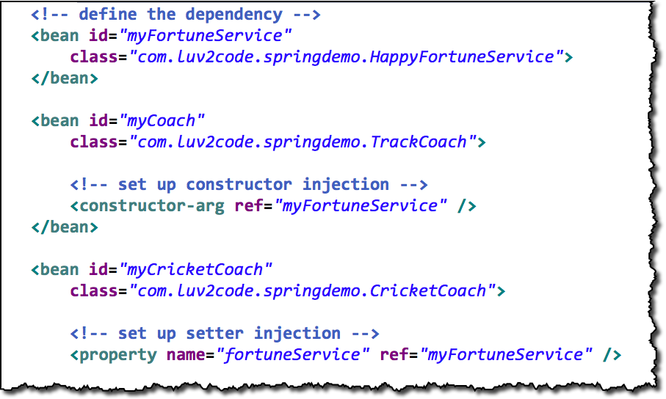
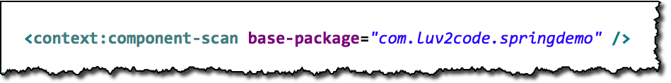
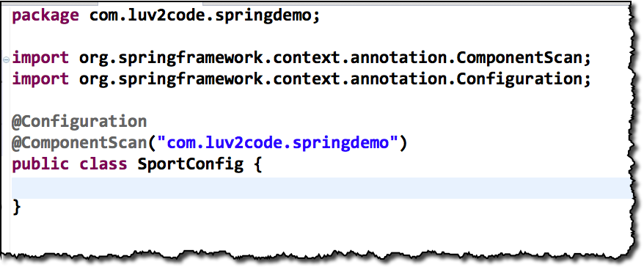
3 Ways of Configuring Spring Container
1. Full XML Config
2. XML Component Scan
3. Java Configuration Class
No XML!
www.luv2code.com

Slide 4
Development Process
Step-By-Step
Create a Java class and annotate as @Configuration
Add component scanning support: @ComponentScan (optional)
Read Spring Java configuration class
Retrieve bean from Spring container
www.luv2code.com

Slide 5

Step 1: Create a Java class and annotate as @Configuration
@Configuration
public class SportConfig {
}
www.luv2code.com

Slide 6

Step 2: Add component scanning support: @ComponentScan
Optional
@Configuration @ComponentScan("com.luv2code.springdemo") public class SportConfig {
}
www.luv2code.com

Slide 7

Step 3: Read Spring Java configuration class
AnnotationConfigApplicationContext context =
new AnnotationConfigApplicationContext(SportConfig.class);
www.luv2code.com

Slide 8

Step 4: Retrieve bean from Spring container
Coach theCoach = context.getBean("tennisCoach", Coach.class);
www.luv2code.com

Slide 9


Defining Beans with Java Code

Slide 10
Defining Beans in Spring
Full XML Config
Java Configuration Class
No XML!
www.luv2code.com

Slide 11


Our New Coach …
No special
annotations
public class SwimCoach implements Coach {
...
}
Coach
FortuneService
www.luv2code.com

Slide 12
Development Process
Step-By-Step
Define method to expose bean
Inject bean dependencies
Read Spring Java configuration class
Retrieve bean from Spring container
www.luv2code.com

Slide 13

Step 1: Define method to expose bean
@Configuration
public class SportConfig {
@Bean
public Coach swimCoach() {
SwimCoach mySwimCoach = new SwimCoach();
return mySwimCoach;
}
}
No component scan
www.luv2code.com

Slide 14

What about our dependencies?
Coach
FortuneService
www.luv2code.com

Slide 15

Step 2: Inject bean dependencies
@Configuration
public class SportConfig {
@Bean
public FortuneService happyFortuneService() { return new HappyFortuneService();
}
@Bean
public Coach swimCoach() {
SwimCoach mySwimCoach = new SwimCoach( happyFortuneService() );
return mySwimCoach;
}
}
www.luv2code.com

Slide 16
Step 3: Read Spring Java configuration class
AnnotationConfigApplicationContext context =
new AnnotationConfigApplicationContext(SportConfig.class);
www.luv2code.com

Slide 17
Step 4: Retrieve bean from Spring container
Coach theCoach = context.getBean("swimCoach", Coach.class);
www.luv2code.com

Slide 18
What about our dependencies?
SwimCoach
SadFortuneService
www.luv2code.com

Slide 19
Injecting Values from Properties File

Slide 20


Read from a Properties File
emailAddress:
team:
properties file
SwimCoach
FortuneService
www.luv2code.com

Slide 21
Development Process
Create Properties File
Load Properties File in Spring config
Reference values from Properties File
Step-By-Step
www.luv2code.com

Slide 22

Step 1: Create Properties File
File: sport.properties
foo.email=myeasycoach@luv2code.com foo.team=Awesome Java Coders
www.luv2code.com

Slide 23

Step 2: Load Properties file in Spring config
File: SportConfig.java
@Configuration @PropertySource("classpath:sport.properties") public class SportConfig {
…
}
www.luv2code.com

Slide 24


Step 3: Reference Values from Properties File
File: SwimCoach.java
public class SwimCoach implements Coach {
@Value("${foo.email}") private String email;
@Value("${foo.team}") private String team;
...
foo.email=myeasycoach@luv2code.com foo.team=Awesome Java Coders
}
www.luv2code.com

